Slide 1
BPMS
<<Project Name>>
<<ProGear ID>>
<<Project Owner Name>>
<<BB Name>>

Slide 2
(ADM) Business Process Management System framework and toolkit
BPMS Phase
Step 1
Step 2
Step 3
Step 4
Step 5
Step 6
Step 7
Transitions SG
Stage Gate 1: Design
Stage Gate 2: Transfer
Stage Gate 3: Run
BPMS Steps
Build detailed process
Framework
Operation Excellence Risk Assessment
Finalize (input-process-output)
Metrics
Measurement System & Quality Framework setup
Set-up
Reporting
Structure
Visual
Management standardization
Continuous Improvement Roadmap
Key outcomes
Project Charter
Validated Process Steps
Validated Process Maps
Communication plan on project
Current Process Capability Analysis:-
Baselining
FTE Estimation
Risk Assessment / Operational FMEA
Metric Identification
Input measures
Process measures
Output measures
Operational definitions
Set up of repeatable reliable metrics
Baselining on SLA & Target setting
Quality Framework
Governance & Escalation Structure
Reporting Framework
Dashboard designs
Visual Management designed & implemented
LOS for
Process improvement
Basic (QPA) and advance (RPA) automation
Transformation opportunities
Toolkit
Current
SOPs
Kano
ARMI / RACI
Comms Plan
COPIS
Process Mapping (Visio/ PPT)
FMEA (Risk Register/Gprompt)
Volume Baselining
and forecasting (Estimation)
FTE validation (Estimation)
Metric Matrix (Measurement Plan/PPM Workbook)
Data Collection Plan
Measurement System Analysis using Gage R&R
Quality Framework
Client governance templates
Reporting matrix
Excel based Dashboards
Escalation Matrix template
Governance in Action
Whiteboards, display walls
CI roadmap / VGR
++
Smart Modeler
Epiplex
Service Lines based Risk CMP 1.0
Benchmarking tool
SEPs (OnePAL measurement framework for lifecycle)
WAM (Gprompt,PHI)
Digital Twin
FLM Cockpit
Quality Control framework
Benchmarking tool
Digital Dashboards/ Visualization tools (PHI)
Red Phone/ Escalation Matrix
Digital Dashboards/ Visualization tools Mojo Meter (PHI)
Gemba Checklist
VSM
Prioritization Matrix
(ReuBank, IdeaBox)
*
Recommended Timelines
1-2 weeks
2-3 weeks
2-3 weeks
1-2 weeks
2-3 weeks
2-3 weeks
2-3 weeks
*Its recommended to align the project timelines with that of the Transition timelines
Replication: Project documentation MUST present evidence of leveraging existing repositories/ tools that provide benchmark information for a related activity

Slide 3
Step 1 Building Process Framework

Slide 4
Step 1: Building Process Framework
VOC
“Customer VOC”
Customer
Email to be attached
“Genpact Process Owner VOC”
Customer Name
Operating leader Email to be attached
Genpact Process Owner Name
High level requirements from SOW
Client & GOL VOC to kick start the project, understand their expectations & document as measures of success

Slide 5
Step 1: Building Process Framework
BPMS Project Charter
Client provides a diverse range of services befitting a solution-building partner with a the ability to address various client issues, business activities and marketing plans at both the corporate and organizational levels. Client extends its activities to serve societal needs, and strives to support innovation within society as a whole. In April 2014, they decided to transition their P2P processes like Invoice processing (12 FTEs), Vendor Master (2 FTEs) and Payments (2 FTEs) to Genpact for UK region.
Business Case
A couple of questions the process criticality should answer are:
Why is your process important from the end customer?
If your process did not exist how will it impact your client?
Process Criticality
A couple of questions the project criticality should answer are:
1. Why we are doing this project?
2. Why is it important for client / for Genpact etc.?
Project Criticality
Robust System of metrics - measurable system to enable data capturing, reporting and analysis which will lead to effective opportunity identification and help achieve the process goals .
Performance Dashboard - Weekly Performance Tracker (with Timelines, Owners & Backup’s)
Failure Mode Effect Analysis to identified High Risks and Current Controls
Identify potential improvement opportunities.
Key Project Deliverables
In scope: UK region
Out of scope: Other activities retained onshore (Procurement, Review/Approval, Employee creation, T & E)
Starts: Once Invoice/Expense/Vendor request received
Stops: Once clearing of payment is done after reconciliation.
Boundaries
Project Leader –
Champion -
Mentor-
Project Team

Slide 6
Step 1: Building Process Framework
BPMS ARMI and Communication Plan
Stakeholder | Role | Risk Assessment | Measurement System | Insights and improvement
 | Sponsor
 | Champion
 | Quality Leader
 | MBB
 | Black Belt
 | Project Owner
 | Project Team
A Approval of team Decisions e.g. Sponsor, Champion, MBB.
R Resource to the Team, one whose expertise skills may be needed on ad-hoc Basis
M Member of the team, with the authorities and boundaries of the Charter
I Interested party, one who will need to be informed
BPMS Communication Plan
Event | Message | Audience | Frequency | Responsibility | Medium
Monthly Reviews
Toll Gate reviews
Project Review with Mentor
Resource Meeting

Slide 7
Step 1: Building Process Framework
Project Plan for BPMS Project

Slide 8
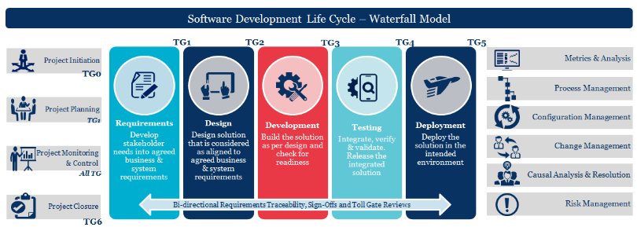
Step 1: Building Process Framework
COPIS – Waterfall Methodology
O
P
Process
S
C
Output
I
Supplier
Customer
Input
Software/Code
Design Documents
Test Results
Requirements
SOW
Test Data
<Customer Name>
HR
IT Team
Support Teams
Vendors
Start
End
Choose the process based on applicability

Slide 9
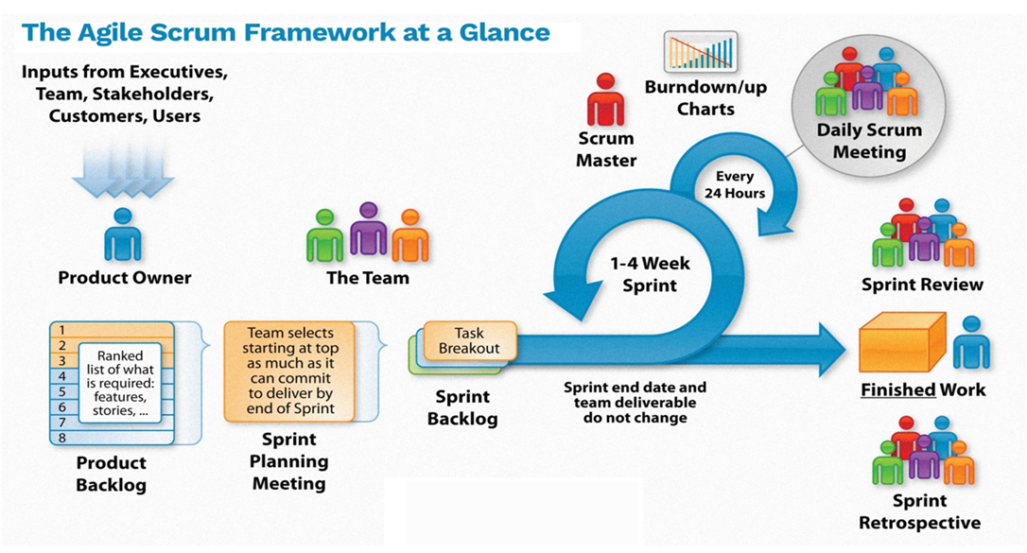
Step 1: Building Process Framework
COPIS- Agile Methodology
O
P
Process
S
C
Output
I
Supplier
Customer
Input
Software/Code
Design Documents
Test Results
Release Notes/ Documents
Requirements
SOW
Test Data
<Customer Name>
HR
IT Team
Support Teams
Vendors
Customer(s)
Start
End
Choose the process based on applicability

Slide 10
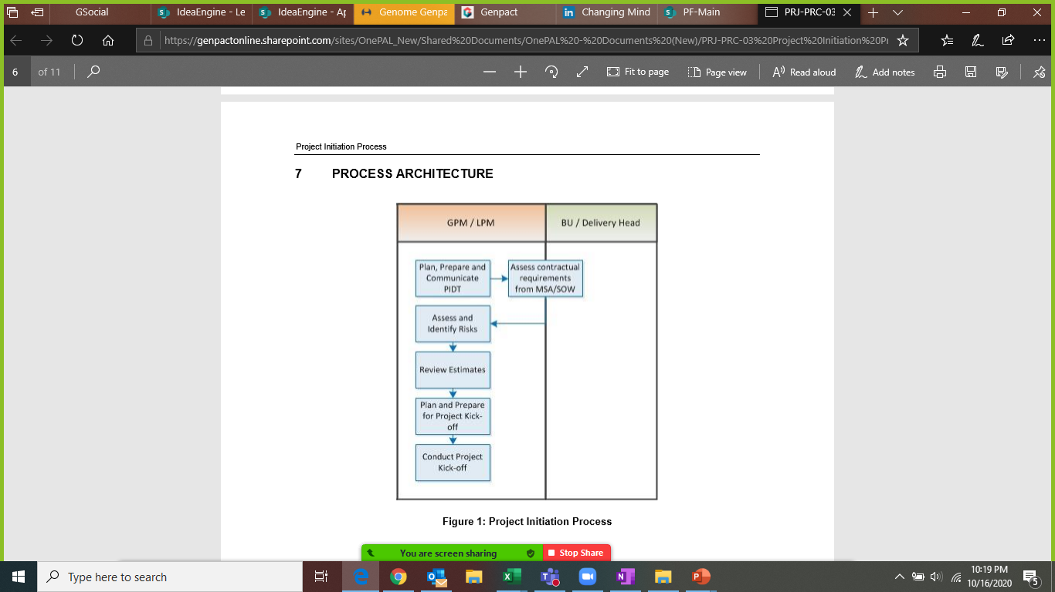
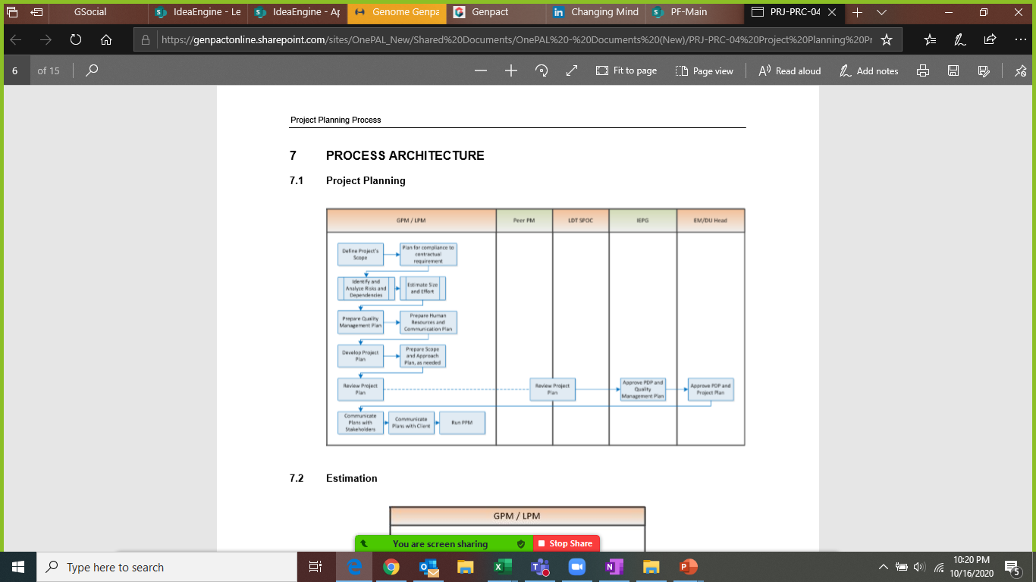
Step 1: Building Process Framework
Project Initiation
Project Planning

Slide 11
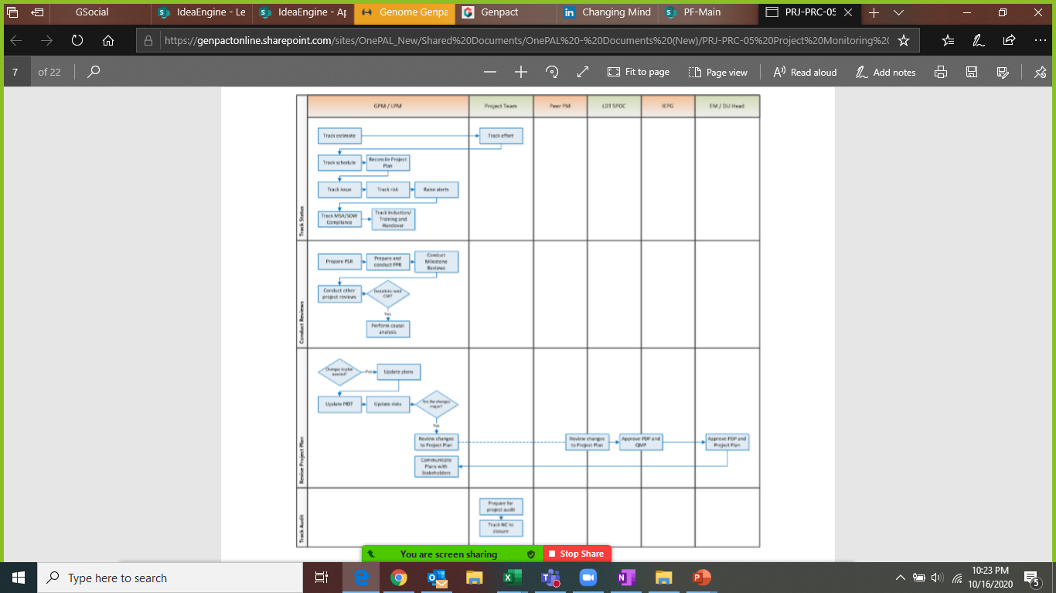
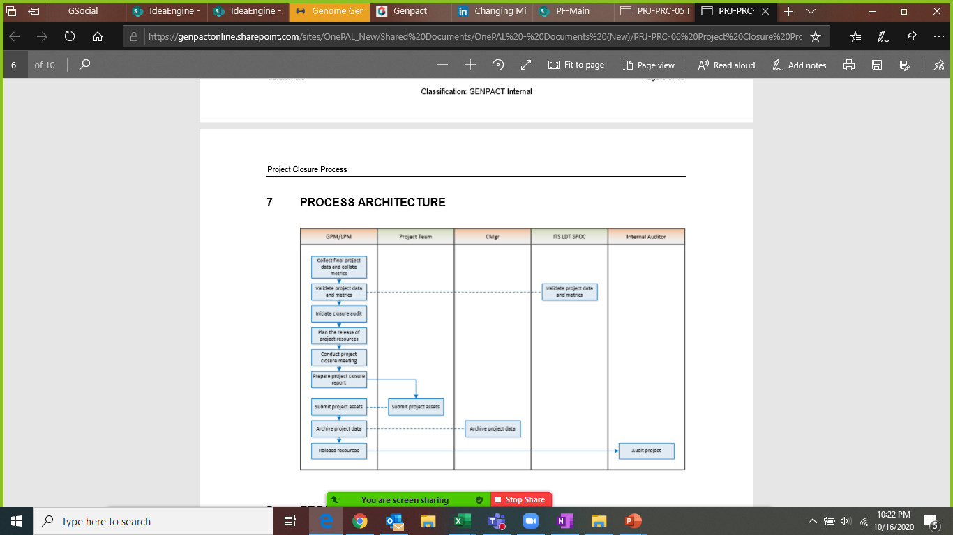
Step 1: Building Process Framework
Project Monitoring & Control
Project Closure

Slide 12
Step 2 Operational Excellence Risk Assessment

Slide 13
Step 2: Operational Excellence Risk Assessment
Risks in the Project /Process
Ref. No. | Risk Event | Description | Risk Category | Status | Probability | Impact | Current Risk Exposure
 |  |  |  |  |  |  | 0
 |  |  |  |  |  |  | 0
 |  |  |  |  |  |  | 0
 |  |  |  |  |  |  | 0
 |  |  |  |  |  |  | 0
 |  |  |  |  |  |  | 0
 |  |  |  |  |  |  | 0
Risk Register Template

Slide 14
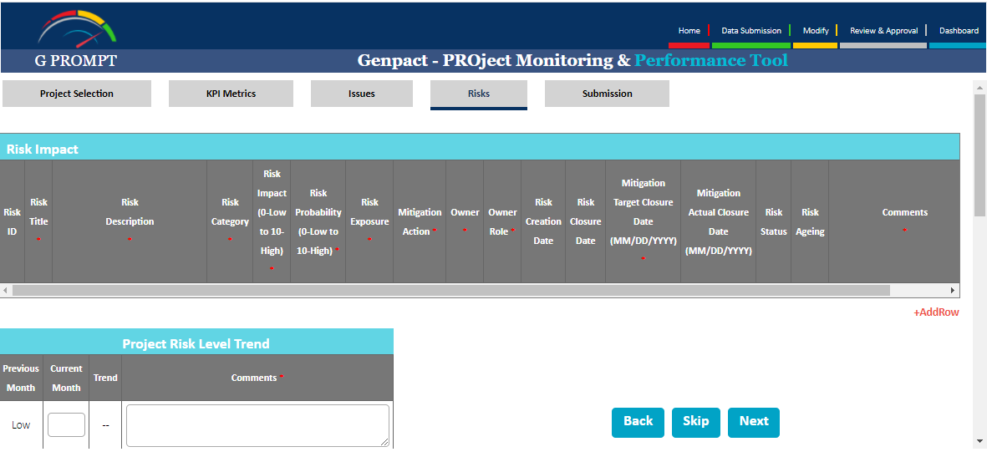
Step 2: Operational Excellence Risk Assessment
Risk Management- GPROMPT
Sample
Please visit below link to update your risks information
https://genpactonline.sharepoint.com/sites/G_PROMPT/SitePages/SubmitMetrics.aspx
Please paste a screenshot of the GPROMPT risks specific to your projects, in this slide

Slide 15
Step 2: Operational Excellence Risk Assessment
Data Collection Plan
Measure / Metric | Data Type | Operational Definition | Stratification / Sampling Factor | Method of Collection | Owner
Efforts | Continuous | Total development efforts spent in a project | Technology and complexity | From PPBR database (PHI tool) | PM
Size

Slide 16
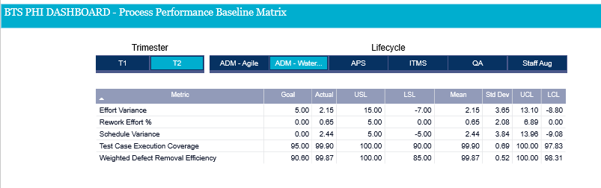
Step 2: Operational Excellence Risk Assessment
Baselining- PPBR Waterfall (PHI dashboard) – Org Level
Please visit below link to set your targets basis selected lifecycle and metrics
https://app.powerbi.com/groups/c675e9c8-23b6-4187-b0ca-8c01082e2969/reports/ac3ba929-bee7-4f6e-add2-3c65823be174/ReportSectionb3451be53337bcc6cb8a

Slide 17
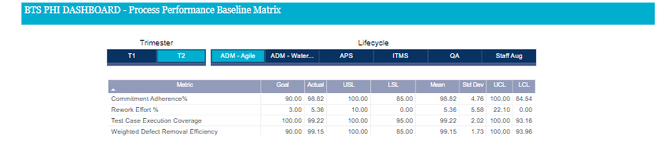
Step 2: Operational Excellence Risk Assessment
Baselining- PPBR Agile (PHI dashboard) – Org Level
Please visit below link to set your targets basis selected lifecycle and metrics
https://app.powerbi.com/groups/c675e9c8-23b6-4187-b0ca-8c01082e2969/reports/ac3ba929-bee7-4f6e-add2-3c65823be174/ReportSectionb3451be53337bcc6cb8a

Slide 18
Step 2: Operational Excellence Risk Assessment
FTE Estimation- Basis Size & Effort
Screen Name | Multiplier Factor | Validations | Complexity | Dependencies | Reference to Base Document | GENPACT Points
 |  |  |  |  |  |  |  | Complexity |  |  | Definition
 |  |  |  |  |  |  |  | Simple | S | 1.00
 |  |  |  |  |  |  |  | Medium | M | 1.50
 |  |  |  |  |  |  |  | Complex | C | 2.50
 |  |  |  |  |  |  |  | Very Complex | V | 4.00
 |  |  |  |  |  |  |  | Dependencies |  |  | Definition
 |  |  |  |  |  |  |  | None | N | 1.00
 |  |  |  |  |  |  |  | Low | L | 1.25
 |  |  |  |  |  |  |  | Medium | M | 1.50
 |  |  |  |  |  |  |  | High | H | 2.00
In case above estimation method not followed, please paste a screenshot of project specific estimation followed

Slide 19
Step 3 Finalize ( Input, Process and Output) Metrics

Slide 20
Step 3: Finalize (input / process / output) Metrics
BPMS ► Finalizing Metrics (Input, Process & Output)
Metric Matrix – Waterfall Methodology
Metric | Measurement Objectives | Priority of Measurement Objective | Base Measures | Collection Technique | Consolidation and Analysis Technique | Responsibility | Frequency of Analysis and Reporting
<Effort Deviation> | Increase EBIDTA - Delivery within budget | 1 | Planned Effort Actual Effort> | Project Tracker | Consolidation: Project Tracker Analysis: 7 QC Tools | Offshore Dev LPM / Technical Lead | Monthly
<Schedule Deviation> | Achieve and Sustain Customer satisfaction - CSAT | 2 | Planned Schedule Actual schedule | Project Tracker | Consolidation: Project Tracker Analysis:7 QC Tools | GPM | Release-wise
<Weighted Defect Removal Effectiveness> | Achieve and Sustain Customer satisfaction - CSAT | 3 | # of weighted external and Internal Defects | Project Tracker | Consolidation: Project Tracker Analysis: 7 QC Tools | GPM | Release-wise
NPS-Net Promoter Score | Achieve and Sustain Customer satisfaction - NPS | 3 | NPS Rating on a scale of 1 to 10 | VOC Tool | Consolidation: VOC Tool Analysis: 7 QC Tools | GPM | As mandated by Corporate
PCS- Process Compliance Score | Compliance to defined process | 4 | PCS from 0% to 100% | Audit Checklists, Auditing Tool | Consolidation: Applicable Audit Checklist, Auditing Tool Analysis: 7 QC Tools | GPM | Quarterly

Slide 21
Step 3: Finalize (input / process / output) Metrics
BPMS ► Finalizing Metrics (Input, Process & Output)
Metric Matrix- Agile Methodology
Metric | Measurement Objectives | Priority of Measurement Objective | Base Measures | Collection Technique | Consolidation and Analysis Technique | Responsibility | Frequency of Analysis and Reporting
Commitment Adherence | To track plan vs accepted story points for every sprint | 1 | -planned story points -Accepted Story points | Project Tracker | Consolidation: Project Tracker Analysis:7 QC Tools | GPM | Every Sprint
Release Burn Down | To know the amount of work completed and remaining. | 2 | Total number of Sprints Total number of delivered story points | Project Tracker | Consolidation: Project Tracker Analysis:7 QC Tools | GPM | Release-wise
<Weighted Defect Removal Effectiveness> | Achieve and Sustain Customer satisfaction - CSAT | 3 | # of weighted external and Internal Defects | Project Tracker | Consolidation: Project Tracker Analysis: 7 QC Tools | GPM | Release-wise
NPS-Net Promoter Score | Achieve and Sustain Customer satisfaction - NPS | 3 | NPS Rating on a scale of 1 to 10 | VOC Tool | Consolidation: VOC Tool Analysis: 7 QC Tools | GPM | As mandated by Corporate
PCS- Process Compliance Score | Compliance to defined process | 4 | PCS from 0% to 100% | Audit Checklists, Auditing Tool | Consolidation: Applicable Audit Checklist, Auditing Tool Analysis: 7 QC Tools | GPM | Quarterly
Sprint Velocity | To track the team productivity. | 1 | -Story points completed -Sprint duration | Project Tracker | Consolidation: Project Tracker Analysis:7 QC Tools | GPM | Every Sprint

Slide 22
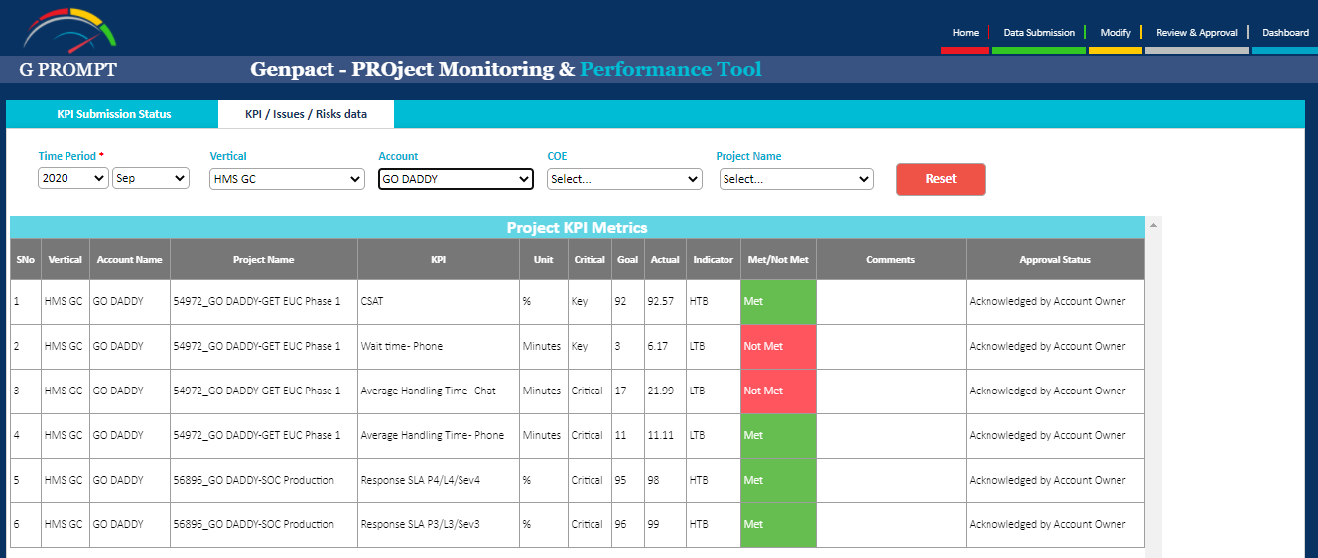
Step 3: Finalize ( Input, Process and Output) Metrics
Metric Matrix- GPROMPT
Sample
Please visit below link to understand the input-Output process measures
https://genpactonline.sharepoint.com/sites/G_PROMPT/SitePages/SubmitMetrics.aspx

Slide 23
Step 4 Setting up Measurement System

Slide 24
Step 4 : Setting up Measurement System
Data Collection Plan
Measure / Metric | Data Type | Operational Definition | Stratification / Sampling Factor | Method of Collection | Owner
Incident Volumes | Discrete | No of incidents created in a given period | Entire population | Form Ticketing tool | PM

Slide 25
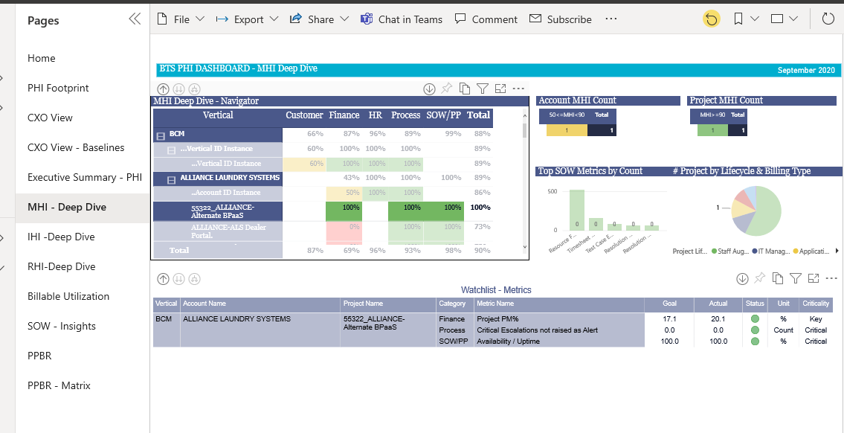
Step 4: Set Up Measurement System
PHI Dashboard
Please visit below link to view the PHI dashboard, Use the MHI- Deep Dive sheet and select vertical, account and project
https://app.powerbi.com/groups/c675e9c8-23b6-4187-b0ca-8c01082e2969/reports/ac3ba929-bee7-4f6e-add2-3c65823be174/ReportSection92d88dc03d737287c300

Slide 26
Step 4: Set Up Measurement System
Quality Framework- Quality Management Plan
Work product review plan
Deliverable | Complexity (High/ Medium/ Low) | Review Technique | Criteria | Sign off By
Project Management Plan | Medium | One-on-One Peer Review | No critical comment | EM / DU Head
Project Defined Process | Medium | Walkthrough | No critical comment | EM / DU Head, IEPG
Project Estimates and Schedule | Medium | One-on-One Peer Review | No comments at ‘Critical’ level | EM
CAR/Defect prevention plan
CAR triggers | CAR frequency | CAR tools to be used | CAR actions leading to best practices/lessons learnt on organization databases
Please paste screen shot of Facilitation & IQA for specific Project PID

Slide 27
Step 4: Set Up Measurement System
Baselining- PPBR (PHI dashboard)
Please visit below link to set your targets basis selected lifecycle and metrics
https://app.powerbi.com/groups/c675e9c8-23b6-4187-b0ca-8c01082e2969/reports/ac3ba929-bee7-4f6e-add2-3c65823be174/ReportSectionb3451be53337bcc6cb8a

Slide 28
Step 5 Setting Up Reporting Structure

Slide 29


Step 5: Setting Up Reporting Structure
BPMS Live ► Step 5 ► Setting Up Reporting Structure
Client Governance
Client
Genpact
Key discussion points
CXOs
Client Functional /
Business Leads
Quality Team**
COO
Sr. GOL
GOL
SDL
GRM / Client Partner
DPIS MBB**
Quarterly Program & Executive Governance
Provide strategic direction to the partnership
Review performance and relationship overall
Seek sponsorship for new opportunities /New Projects initiationl
Steering
Committee
Process Owners /
Service Delivery Managers
Process Managers
Quality Team**
GOL
SDL
Process Managers
DPIS MBB/BB**
Monthly
Operations & Quality Review
Review scorecard and performance
RCA for critical error category and Action Plan
Error Trends & Learnings
Discuss any potential risks & actions thereof
DPIS Review
Review CI roadmap progress as per plan
Management Committee
Process Managers (client)
Daily/Weekly (based on account needs)
Daily operational management
Identify and resolve key process issues
Process Owner Connect
Process Manager (Genpact)
New**
Quality Leader
Quality Manager
Regional Process Owners
SDLs
DPIS MBB
DPIS BB
Quarterly (separate for F&A + non F&A teams)
Status of Projects & Improvement Initiatives
Status of agreed ongoing Action Items
Best Practice & Learnings
Best Practice Sharing Sessions - Monthly in Q4 FY 19 (Later to be revised basis requirement)
Discussion on improvement opportunities across all regions
Quality
Governance

Slide 30
Step 5: Setting Up Reporting Structure
Reporting Matrix
Report | Report Location | Frequency of Update | Frequency of Publishing | Audience Client / Internal | Distribution List | Report Owner

Slide 31
Step 5: Setting Up Reporting Structure
Red Phone / Escalation Matrix
Escalation matrix- Internal
Type of Escalation | 1st Escalation Level | 2nd Escalation Level | 3rd Escalation Level | 4th Escalation Level | 5th Escalation Level | 6th Escalation Level
 | Project Team Contact | Global Project Manager | Account Manager | Engagement Manager | DU / Service Line Head | Executive Level
 | Escalate after <time> | Escalate after <time> | Escalate after <time> | Escalate after <time> | Escalate after <time> | Escalate after <time>
Application Production Failure
Communication Issues
Performance Issues
Schedule Slippage
Process Compliance Issues
Issues with Aspirations
Other
Escalation matrix- External
Type of Escalation | 1st Escalation Level | 2nd Escalation Level | 3rd Escalation Level | 4th Escalation Level | 5th Escalation Level | 6th Escalation Level
 | Client Team Contact | Client Frontline Manager | Client Project Manager | Client Account Manager | Client Project Sponsor | Client Executive Level
 | Escalate after < time> | Escalate after < time> | Escalate after < time> | Escalate after < time> | Escalate after < time> | Escalate after < time>
Delay in query resolution
Communication Issues
Infrastructural Issues
Frequent scope changes
Other

Slide 32
Step 5: Setting Up Reporting Structure
Dashboards- PHI Dashboard
Please visit below link to view the PHI dashboard
https://app.powerbi.com/groups/c675e9c8-23b6-4187-b0ca-8c01082e2969/reports/ac3ba929-bee7-4f6e-add2-3c65823be174/ReportSection92d88dc03d737287c300
Please use either the PHI dashboard or customer mandated template

Slide 33
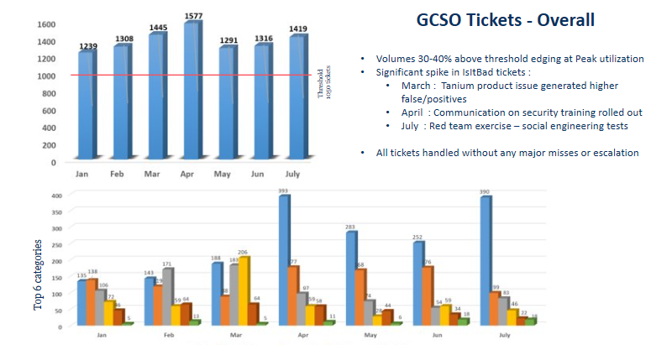
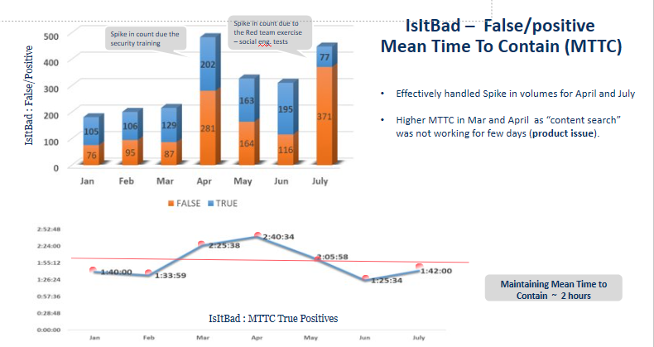
Step 5: Setting Up Reporting Structure
Dashboards – Customer Status Report Dashboards
Sample

Slide 34
Step 6
Visual Management Standardization

Slide 35
Step 6: Visual Management Standardization
Digital Dashboard
Please use either of following:
Kanban board
Whiteboard/digital whiteboard like Iobeya etc. as used in the project for visual management
Then paste a screen shot of above on this slide

Slide 36
Step 6: Visual Management Standardization
Dashboards – Customer Status Report Dashboards
Sample

Slide 37
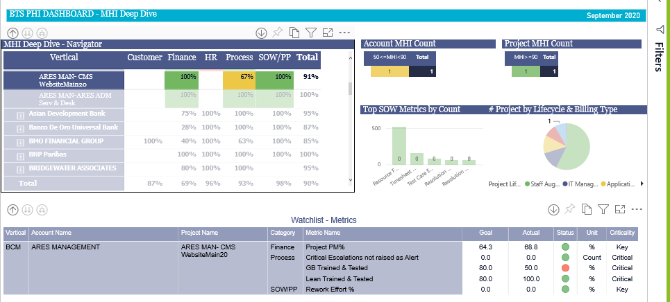
Step 6: Visual Management Standardization
PHI Dashboard
https://app.powerbi.com/groups/c675e9c8-23b6-4187-b0ca-8c01082e2969/reports/ac3ba929-bee7-4f6e-add2-3c65823be174/ReportSection92d88dc03d737287c300
Please use either the PHI dashboard or customer mandated template
Please visit above site and take a screenshot of LSS DNA for your specific project (PID)- and paste on this slide

Slide 38
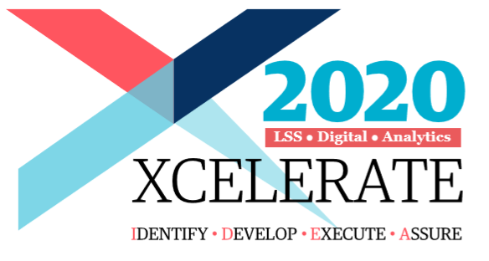



Step 6: Visual Management Standardization
DPIS, Ops Effectiveness
LSS DNA
Take charge, say it with
Amber
Emma
On-demand Op Excellence!
Genpact’s new culture assistant, powered by AI
LSS DNA
Emma
On-demand Op Excellence!
Lean T & T %
Ideas Generated
% of people who have chatted
80%
242
80%
Lean Certified%
Ideas Approved
% of GB Owners Chatted
20%
200
75%
GB T & T %
Ideas Completed
% of Lean Owners Chatted
80%
15
85%
GB Certified%
BI Delivered
20%
1.3MM
Communication Templates

Slide 39
Step 7 Continuous Improvement Roadmap

Slide 40
Process Map – Kaizens
Master Data Issues
Setup Issues
Flexera Code Issues
Quote submitted in SFDC
User trainings issues
SFDC
Flexera code creates Assest for Software lines
Flexera file generated in fusion and sent to Bhoomi
Flexera task released
Order fulfilled and closed
Order created in Fusion
Credit & Export Compliance completed
Fusion
Shippable lines are picked and shipped

Slide 41
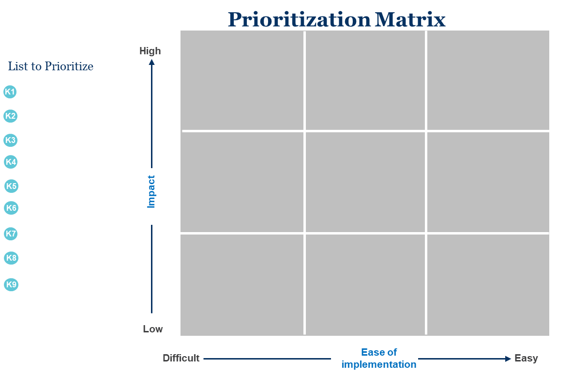
Step 7: Continuous Improvement
Control Impact Matrix
# | Solution | Impact (High , Low, Medium) | Effort (High , Low, Medium)
1
2
3
4
5
6
7
8
Notes:
Have a quick understanding check on alignment of stage gates to BPMS steps and what are critical deliverables at each stage

Slide 42
Step 7: Continuous Improvement
BPMS Live ► Step 7 ► Continuous Improvement Opportunities ►
Control Impact Matrix
Prioritization Matrix
List to prioritize
Long Term
Short Term
Just do it
P1
High
6+ months
3-6 months
0-3 months
P3
P4
P2
P5
P8
P3
P9
P2
P4
P1
P7
P5
Impact
P6
P11
P10
P6
P7
P8
P9
Low
P10
Low
Ease of Implementation
High
P11
People / Process
Technology

Slide 43
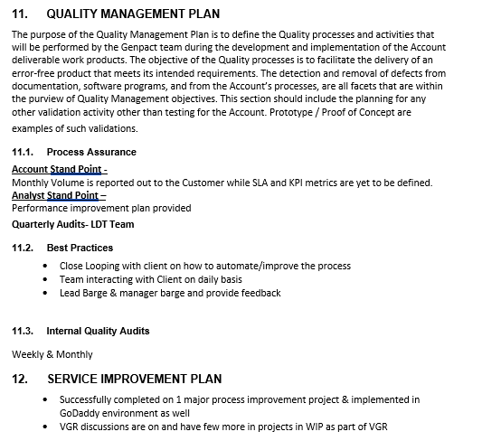
Step 7: Continuous Improvement Roadmap
Quality plan and Service Improvement plan snapshot-GoDaddy SOC
Sample

Slide 44
Step 7: Continuous Improvement Roadmap
BPMS Live ► Step 7 ► Continuous Improvement Opportunities ►
Year Name- ___________ Roadmap
Jan
Feb
Mar
Apr
May
Jun
Jul
Aug
Sep
Oct
Nov
Dec
Ideation Labs
MTTR (Mean Time To Resolve) Reduction
Shared Pool Fragmentation
Proactive index maintenance
Idea Prioritization & Quantification
Reorganization of Database
Sample
Process correction to reduce rework and firefighting
Automation of DB Validation
Enabling email option on CCSN to all engineers
Recompilation of Invalid Objects
Reduction of errors during DB connection
Automation of DBAP table cleanup
Obsolete File Purging
Proactive Performance Monitoring
Automation of checking file system utilization
Implementation of best practices from other accounts and Lean Ideas (Automation Of reports, etc)
LEAN
Six Sigma
Notes:
44

Slide 45
Step 7: Continuous Improvement Roadmap
Process Improvements
Source of improvement, solution evaluation and roadmap creation
1. Please visit IdeaBox, Best Practices & Lessons learnt, ReuBank databases (links below), take a screenshot of corresponding assets submitted by the specific project/account- and paste it on this slide
In case no assets have been submitted, please submit some corresponding assets and then paste the screen here
https://genpactonline.sharepoint.com/sites/CMITS_IDEA_BOX/SitePages/IdeaHome.aspx
https://genpactonline.sharepoint.com/sites/CMITS_IDEA_BOX/SitePages/BBHome.aspx
https://genpactonline.sharepoint.com/sites/CMITS_IDEA_BOX/SitePages/LessonHome.aspx?level1=Lessons%20Learnt
https://genpactonline.sharepoint.com/sites/OnePAL_New/SitePages/ReuBankHome.aspx
2. Please paste a screen shot of any Continuous improvement/Kaizen/VGR- done for your specific project- and paste it here

Slide 46
Project Approvals
Champion Approval Email
Sponsor Approval Email

Slide 47
Thank You.

Slide 48
Building Process
Framework
This is the first step in a BPMS Live project.
This aims to build the main structure for the account being transitioned by understanding the requirement and process.
Key Outcomes:
Project Charter
Validated Process Steps
Validated Process Maps
Communication plan on project
What needs to be done | Tool | Description | Must / Good to Have | Template / Resource
Build Business Case | VOC | The “voice of the customer” is a process used to capture the requirements/feedback from the customer. | Must Have | Template
 | KANO | This is an approach to prioritizing features on a product roadmap based on the degree to which they are likely to satisfy customers. | Good to Have | Template
 | Project Charter | A project charter is a formal document that describes the project in its entirety — including what the objectives are, how it will be carried out, and who the stakeholders are. | Must Have | Template
 | ARMI / RACI | ARMI is a project management tool that can be used to analyze the level of support of project stakeholders. A RACI chart is a simple matrix used to assign roles and responsibilities for each task, milestone, or decision. | Must Have | Template
Establish project plan | Communication Plan | This is a systematic approach for providing information to the stakeholders. The plan defines who should be given information, when it should be delivered and what communication channels will be used. | Must Have | Template
 | Project Plan | Project plan is a live document, which is used to communicate the project status to the stakeholders against the milestones. | Must Have | Template
Validate client processes | COPIS | Provides high-level view of process, helps in identifying the key stakeholders (customers and suppliers) and defines process boundaries (start and stop of the process). | Must Have | Template
 | Process Map | It is a graphical representation of steps, events, and relationship of steps within a process. | Must Have | Template
 | Visio | This is a software that makes creating flow charts, diagrams and charts easier. | Good to Have | Resources
 | Epiplex | Captures and develop standard operating procedure using rapid authoring technology | Good to Have | Resources
 | Smart Modeler | Tool used for process mapping, documentation and collaborative reporting. | Good to Have | Resources
This phase helps link the opportunity with the solution, validating gaps in the current process with data or Process
Phases
Outcomes
Enhanced!
New!
Steps
New!
Timelines
This page applies if you have > 30 data points

Slide 49
Operational
Excellence
Risk Assessment
The second step focuses on ensuring that we understand the capability of those processes identified in step 1.
Any risk associated with the processes are identified and controls put in place to reduce the risk / impact.
Key Outcome:
Current Process Capability Analysis:-
Baselining
FTE Estimation
Risk Assessment / Operational FMEA
What needs to be done | Tool | Description | Must / Good to Have | Template / Resource
Conduct Risk Assessment | FMEA | This is a tool that helps us anticipate what might go wrong with a product or process as well as identify the possible causes and probabilities of failures. | Must Have | Template
Data Collection | Data Collection Plan | Plan what data will be collected, when it is collected, where it will be collected from, how it will be collected, who will collect it and the volume/sample size to be collected. | Must Have | Template
Volume Baselining and Forecasting | Baselining | Baselining is process of assessing the current state of the volume in the process. | Must Have | Resources
 | Volume Analysis | Analyze baseline information to understand the nuances and movement of volume of work for the process. | Must Have | Sample
Benchmarking | Benchmarking Tool | Establish standard metrics and enable input into Benchmarking Tool for insights. | Good to Have | Resources
FTE Validation | FTE Validation | Check for rigor and calculations on FTE estimation. Check if the Sol Id vs current or actual FTEs. | Must Have | Sample
Service Line Based Risk | Common Minimum Practice | This is a ready reference of standards to help strengthen our existing service delivery / day to day operations. | Good to Have | Resources
Enhanced!
Phases
New!
Outcomes
New!
Steps
Timelines
This page applies if you have > 30 data points

Slide 50
This thirds step focuses on metric identification to include input, output and process metrics that needs to be monitored to ensure compliance to goals.
Key Outcome:
Metric Identification
Input measures
Process measures
Output measures
Operational definitions
Finalize (input/
process/
output metric)
What needs to be done | Tool | Description | Must / Good to Have | Template / Resource
Metric Identification | Metric Matrix | Achieve a clear understanding of the difference between Input-Process-Output measures. | Must Have | Template
 | SEP | Smart Enterprise Processes takes an outcome based view of managing business processes. | Good to Have | Resources
New!
Timelines
This page applies if you have > 30 data points

Slide 51
Setting Up
Measurement
System
The fourth step focuses on creating measurement system around the metrics established.
This is were these systems will also be tested on efficiency.
Key Outcome:
Set up of repeatable reliable metrics
Baselining on SLA & Target setting
Quality Framework
What needs to be done | Tool | Description | Must / Good to Have | Template / Resource
Collect Data | Data Collection Plan | Plan what data will be collected, when it is collected, where it will be collected from, how it will be collected, who will collect it and the volume/sample size to be collected. | Must Have | Template
 | WAM | Is a work activity tool that identify dynamics of activity of an employee working with a computer. | Good to Have | Resources
 | Digital Twin | Is a software model that relies on system data to recreate how process actually executes across different systems. | Good to Have | Resources
 | FLM Cockpit | This is a one view dashboard to provide live update on the BAU operation, to the top management, with a click of a button | Must Have | Resources
Measurement System Analysis | Gage R&R | A statistical tool that measures the amount of variation in the measurement system arising from the measurement device and the people taking the measurement. | Must Have / As Applicable | Template
Quality Assurance | Quality Framework | Establish a quality outline that would provide guidance to operations around quality requirements. | Must Have | Sample
Baselining and Target Setting | Baselining and Target Setting | Identification of goal for all metrics for both Genpact and Client, including inputs. | Must Have | Sample
 | Benchmarking | Establish standard metrics or gather inputs from the practice team for industry benchmarks. | Must Have | Sample
 | Benchmarking Tool | Establish standard metrics and enable input into Benchmarking Tool for insights. | Good to Have | Resources
New!
New!
New!
New!
New!
Phases
New!
Outcomes
Steps
New!
Timelines
This page applies if you have > 30 data points

Slide 52
Setting Up
Reporting
Structure
Fifth step of the methodology is setting up reports around the measurement identified during previous step.
Key Outcome:
Governance & Escalation Structure
Reporting Framework
Dashboard designs
What needs to be done | Tool | Description | Must Have | Template / Resource
Governance and Escalation Structure | Client Governance | Provides a structure of how the client interaction and communication should be carried out. | Must Have | Template
 | Reporting Matrix | Identify all reports that needs to go out to your internal and external stakeholders and requirements for each. | Must Have | Template
 | Escalation Matrix / Red Phone | Emergency contact number for one to one connect between Senior customer stakeholder & Genpact GOL/SDL for exigencies & high level escalations | Must Have | Template
Reporting Framework and Design | Dashboards | These can be excel dashboards that provide insight on the data being measured. | Must Have | Sample
 | Digital Dashboard Power BI | Digital visualization of reports with capability to provide analytics and real time update. | Good to Have | Resource
 | Digital Dashboard Qlik Sense | Digital visualization of reports with capability to provide analytics and real time update. | Good to Have | Resource
New!
Phases
New!
Outcomes
New!
Steps
Timelines
This page applies if you have > 30 data points

Slide 53
Visual Management
Standardization
This step will ensure that there is effective visualization of reports and other communications for all employees.
Key Outcome:
Visual Management designed & implemented
What needs to be done | Tool | Description | Must / Good to Have | Template / Resource
Visual Displays in Operations | Whiteboards / Display Wall | Visualization of reports using displays like whiteboards or pop ups that are often updated manually. | Must Have | Available Resources can be used
Digital Reporting | Power BI | Digital visualization of reports with capability to provide analytics and real time update. | Good to Have | Sample
 | Qlik Sense | Digital visualization of reports with capability to provide analytics and real time update. | Good to Have | Sample
Mojo Implementation | Mojo Meter | Showcase of current mojo meter rating for each accounts with action items for improvement. | Must Have | Resource / Template
 | LSS Wall | Interactive wall for display of LDT related communications and status of activities such as projects, hackaton, Xcelerate etc. | Must Have | Sample
New!
New!
Phases
New!
New!
Outcomes
Steps
Timelines
This page applies if you have > 30 data points

Slide 54
Continuous
Improvement
Opportunities
Step 7 is included in the BPMS methodology to ensure that operational needs are met with continuous improvement activities and projects.
Objective:
LOS for
Process improvement
Basic (QPA) and advance (RPA) automation
Transformation opportunities
What needs to be done | Tool | Description | Must / Good to Have | Template / Resource
Understand source of opportunity | VSM | Value stream mapping is a technique for identifying and eliminating waste from a process. | Must Have | Sample / Resource
Solution evaluation | Control Impact Matrix | This is a prioritization tool comparing the control and impact of a certain solution to identify which one to work on first. | Must Have | Template
 | Prioritization Matrix | Tool used to identify projects that needs to be prioritized basis criteria identified by stakeholders. | Must Have | Template
Roadmap Creation | CI Roadmap / VGR | These are the kaizen / projects identified through the VSM to be accomplished for continuous improvement. Line of sight for transformational initiatives and changes for the account moving forward. | Must Have | Template
New!
New!
New!
Phases
Enhanced!
Outcomes
Steps
Timelines
This page applies if you have > 30 data points

